Slide 1

Global Happiness Index Analysis
This presentation analyzes the Global Happiness Index. We explore economic, social, and psychological factors influencing well-being and quality of life across nations.
By M. Mahesh (192224092)
P. V. N Sai Ganesh(192224205)
M

Slide 2

Introduction
1
Happiness Defined
2
Global Perspective
Subjective well-being, encompassing life satisfaction, positive emotions, and low negative emotions.
Examining happiness across different cultures and socioeconomic contexts.
3
Data Sources
Utilizing the World Happiness Report data and other relevant datasets.

Slide 3
Key Factors
Economic Factors
Social Factors
Psychological Factors
GDP per capita, income inequality, unemployment rates.
Social support, healthy life expectancy, freedom.
Trust, generosity, perceived corruption.

Slide 4



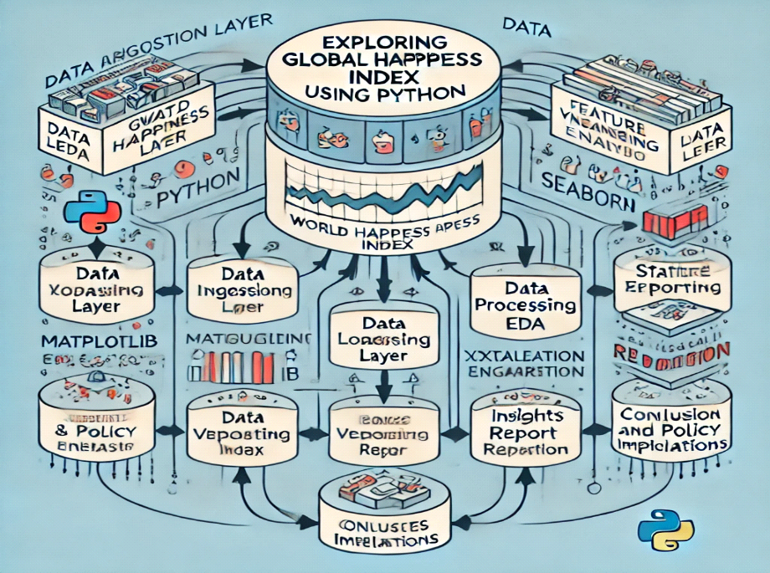
Architecture Diagram
Data Acquisition
Gathering data from various sources.
Data Cleaning
Handling missing values and outliers.
Analysis & Visualization
Performing statistical analysis and creating visualizations.

Slide 5
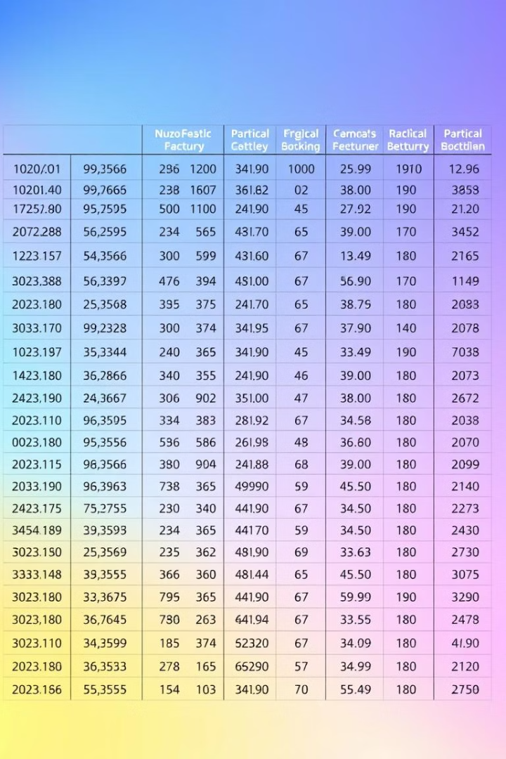
Dataset
Country
Happiness Score
GDP per Capita
USA
6.9
65000
Canada
7.2
50000

Slide 6

Data Preparation
1
Data Cleaning
Handling missing values and outliers.
2
Data Transformation
Scaling and normalization of features.
3
Feature Engineering
Creating new features from existing ones.

Slide 7
Code Skeleton
# Import necessary libraries
import pandas as pd
import matplotlib.pyplot as plt
import seaborn as sns
from scipy import stats
from pandas.plotting import lag_plot, autocorrelation_plot
# Define the dataset within the code
data = {
'Country': ['Finland', 'Denmark', 'Norway', 'Iceland', 'Netherlands', 'Switzerland', 'Sweden', 'New Zealand',
'Canada', 'Austria', 'Australia', 'Israel', 'Costa Rica', 'Ireland', 'Germany', 'United States',
'Czech Republic', 'Belgium', 'United Kingdom', 'Mexico'],
'Happiness Rank': [1, 2, 3, 4, 5, 6, 7, 8, 9, 10, 11, 12, 13, 14, 15, 16, 17, 18, 19, 20],
'Happiness Score': [7.769, 7.600, 7.554, 7.494, 7.488, 7.480, 7.343, 7.307, 7.278, 7.246, 7.228, 7.190, 7.167,
7.129, 7.076, 6.892, 6.852, 6.834, 6.796, 6.595],
'GDP per Capita': [1.340, 1.383, 1.488, 1.380, 1.396, 1.452, 1.387, 1.303, 1.365, 1.376, 1.372, 1.276, 1.034,
1.499, 1.373, 1.433, 1.269, 1.356, 1.333, 1.080],
'Social Support': [1.587, 1.573, 1.582, 1.624, 1.522, 1.526, 1.487, 1.557, 1.505, 1.475, 1.548, 1.455, 1.441,
1.553, 1.454, 1.457, 1.487, 1.504, 1.538, 1.323],
'Healthy Life Expectancy': [0.986, 0.996, 1.028, 1.026, 0.999, 1.052, 1.009, 1.026, 1.039, 1.016, 1.036, 1.029,
0.963, 1.010, 0.987, 0.874, 0.920, 0.986, 0.996, 0.861],
'Freedom to Make Life Choices': [0.596, 0.592, 0.603, 0.591, 0.557, 0.572, 0.574, 0.585, 0.584, 0.532, 0.557,
0.371, 0.558, 0.516, 0.495, 0.454, 0.457, 0.473, 0.450, 0.482],
'Generosity': [0.153, 0.252, 0.271, 0.354, 0.322, 0.263, 0.267, 0.330, 0.285, 0.244, 0.322, 0.261, 0.144, 0.298,
0.261, 0.280, 0.046, 0.160, 0.348, 0.074],
'Perceptions of Corruption': [0.272, 0.410, 0.341, 0.118, 0.298, 0.343, 0.373, 0.389, 0.308, 0.226, 0.290, 0.082,
0.093, 0.310, 0.265, 0.128, 0.036, 0.210, 0.278, 0.153],
'Dystopia Residual': [2.123, 2.064, 2.154, 2.264, 2.276, 2.163, 2.038, 2.081, 2.131, 2.153, 2.192, 2.309, 2.499,
1.980, 2.064, 1.921, 2.361, 2.113, 1.969, 2.686]
}
# Convert to a pandas DataFrame
df = pd.DataFrame(data)
# Display the first few rows
print(df.head())
# Paired t-test: Check if there's a significant difference between Happiness Score and GDP per Capita
t_stat_paired, p_value_paired = stats.ttest_rel(df['Happiness Score'], df['GDP per Capita'])
print(f"Paired T-statistic: {t_stat_paired}, Paired P-value: {p_value_paired}")
if p_value_paired < 0.05:
print("Significant difference between Happiness Score and GDP per Capita (Reject null hypothesis).")
else:
print("No significant difference between Happiness Score and GDP per Capita (Fail to reject null hypothesis).")
# Independent t-test: Compare Happiness Score for countries with above and below median GDP per Capita
median_gdp = df['GDP per Capita'].median()
above_median_gdp = df[df['GDP per Capita'] > median_gdp]['Happiness Score']
below_median_gdp = df[df['GDP per Capita'] <= median_gdp]['Happiness Score']
t_stat_ind, p_value_ind = stats.ttest_ind(above_median_gdp, below_median_gdp)
print(f"Independent T-statistic: {t_stat_ind}, Independent P-value: {p_value_ind}")
if p_value_ind < 0.05:
print("Significant difference in Happiness Score between countries with above and below median GDP per Capita (Reject null hypothesis).")
else:
print("No significant difference in Happiness Score between countries with above and below median GDP per Capita (Fail to reject null hypothesis).")
# Line Plot: GDP per Capita vs Happiness Score over the Rank
plt.figure(figsize=(10, 6))
plt.plot(df['Happiness Rank'], df['Happiness Score'], label='Happiness Score', marker='o')
plt.plot(df['Happiness Rank'], df['GDP per Capita'], label='GDP per Capita', marker='o')
plt.xlabel('Happiness Rank')
plt.ylabel('Score')
plt.title('Line Plot: Happiness Score and GDP per Capita over Rank')
plt.legend()
plt.show()
# Box Plot: Showing distribution of Happiness Score and GDP per Capita
plt.figure(figsize=(10, 6))
sns.boxplot(data=df[['Happiness Score', 'GDP per Capita']], palette="Set2")
plt.title('Box Plot of Happiness Score and GDP per Capita')
plt.show()
# Heatmap: Correlation between the variables
plt.figure(figsize=(10, 6))
corr_matrix = df[['Happiness Score', 'GDP per Capita', 'Social Support', 'Healthy Life Expectancy',
'Freedom to Make Life Choices', 'Generosity', 'Perceptions of Corruption']].corr()
sns.heatmap(corr_matrix, annot=True, cmap='coolwarm', linewidths=0.5)
plt.title('Heatmap of Happiness Factors Correlation')
plt.show()
Data Loading
Statistical Analysis
Loading the dataset using pandas.
Using scikit-learn for regression models.
Visualization
Using Matplotlib and Seaborn for graphs.

Slide 8
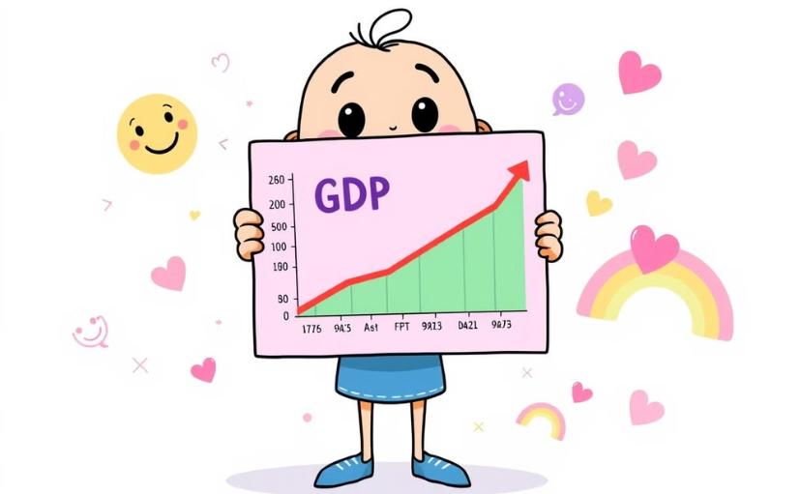
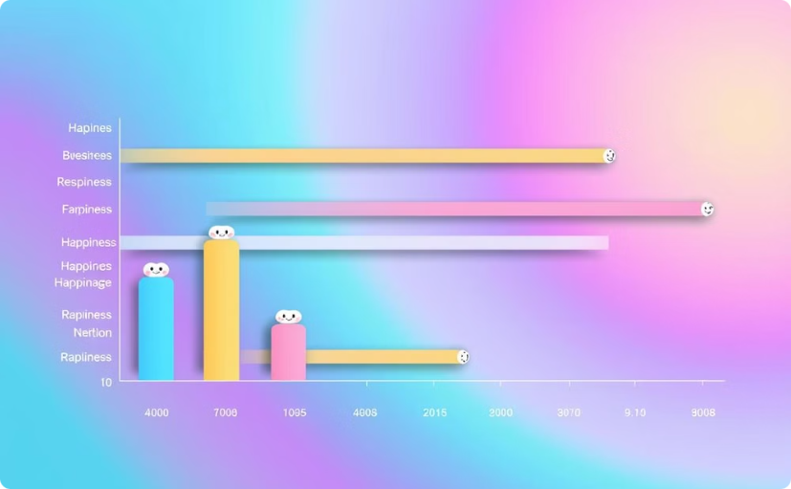
Output
GDP vs Happiness
Regional Happiness
Correlation between economic prosperity and happiness.
Happiness variations across different regions.

Slide 9
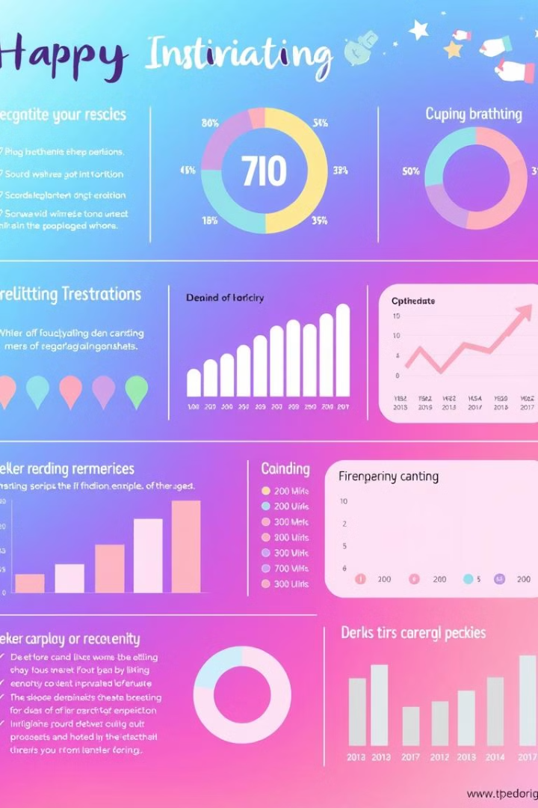
Result Analysis
1
Key Findings
2
Limitations
Significant correlations between factors and happiness.
Data limitations and potential biases in the data.
3
Further Research
Need for deeper investigation into specific factors.

Slide 10




Conclusion and Future Scope
Future Research
Global Impact
Data Enhancement
Explore the dynamics of happiness over time.
Use findings to create better policies for global happiness.
Improve data quality and incorporate more variables.

